Slide 1
DSE 203 Final Presentation
December 10, 2021
Lam Ho, Jonah Breslow, and Jeff Kagan
Notes:
Jeff

Slide 2





Agenda
Topic/Motivation
Datasets
Knowledge Graph
Data Integration
Loading Data into neo4j
Demonstration
Insights/Lessons Learned
Conclusion/Future Work
Questions
Notes:
Jeff
ETA: 30s

Slide 3
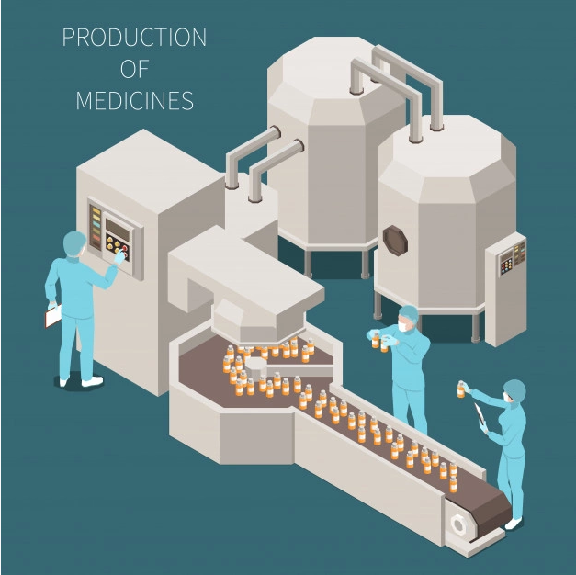

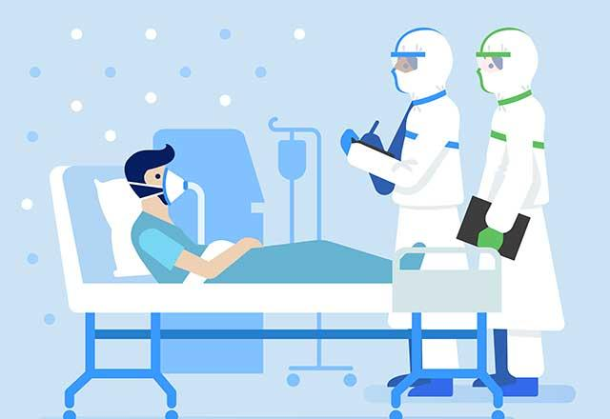
Topic/Motivation
To investigate the flow of money from drug manufacturers to physicians and how that relates to drug prescriptions. Ultimately, we would like to provide a tool with the capability to identify networks of abuse.
Notes:
Jonah
ETA: 30s

Slide 4
Datasets
CMS Open Payments (Sunshine Act)
2019 General Payment Data
Format: CSV, 6.17 GB
Sample Data
Medicare Part D Prescriptions
2019 Dataset
Format: CSV, 343.7 MB
Sample Data
openFDA Drug Labeling
Format: JSON, 6.3 GB over 10 files
https://open.fda.gov/data/downloads/
Notes:
ETA: 60s
Jonah - CMS
Lam - Medicare
Jeff - OpenFDA

Slide 5


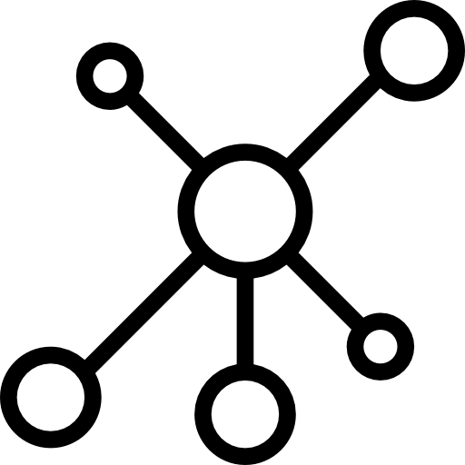


Data Integration Pipeline:
Software Stack
{OpenFDA} JSON
Medicare Part D
Sunshine Act
1.
2.
3.
4.
Source Data & Pre-Processing Transforms
Data Integration Pipeline
Node & Edge Creation
Loading Graph & Querying Network
Notes:
Jonah
ETA: 70s

Slide 6
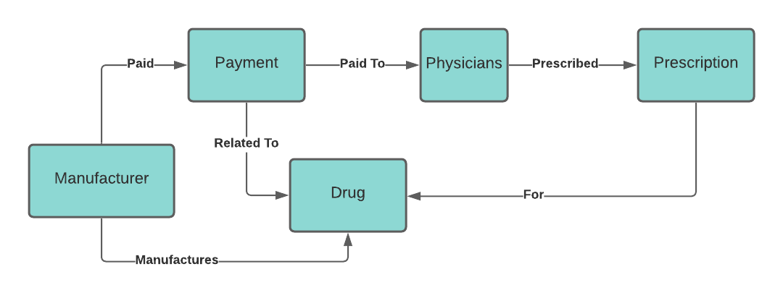

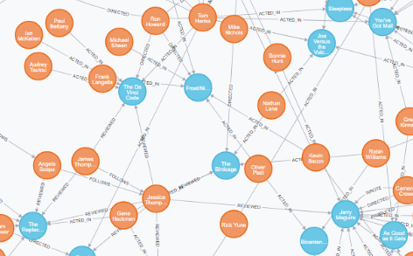
Knowledge Graph
Notes:
Lam
ETA: 45s

Slide 7
Drug Node - Integration
Drug entities were found in all three data sources(Sunshine Act, Medicare Part D, and OpenFDA) without a common identifier.
Problem: Match drugs across all datasets
Goal: Create a drug “universe” table
Executed 1st
Executed 2nd
Executed 3rd
Medicare Part D: Dedupe
Medicare Part D - OpenFDA Matching: Dedupe
OpenFDA: String Matching
Medicare Part D - OpenFDA - Sunshine Act Matching: Dedupe
Sunshine Act: String Matching
Notes:
Jeff (main) and Jonah
ETA: 75s

Slide 8
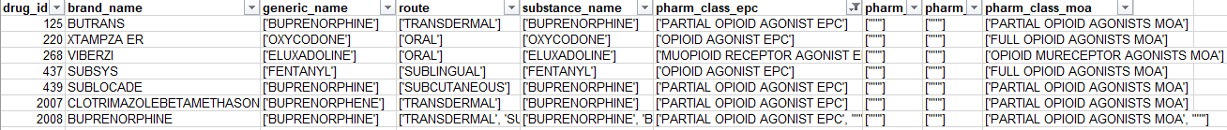
Drug Node - Integration (Cont.)
Processed, integrated, & normalized drug table output:
Result: > 5k drug nodes created
Notes:
Jeff (main)

Slide 9
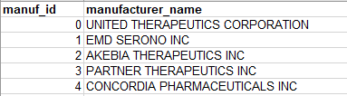
Manufacturer Node - Integration
Manufacturer entities were found in two data sources (Sunshine Act and OpenFDA) without a common identifier.
Problem: Match manufacturers across both datasets
Goal: Create a manufacturer “universe” table
Executed 1st
Executed 2nd
Manufacturer:
OpenFDA: Dedupe
OpenFDA + Sunshine Act Matching: Dedupe
Result: >10k manufacturer nodes created
Notes:
Jeff/Jonah
ETA: 60s

Slide 10
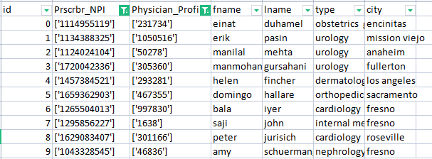
Physician Node - Integration
We had Physicians in the Sunshine Act data and Prescribers in Medicare Part D
Problem: Link Sunshine Act Physicians to Medicare Part D Prescribers
Goal: Generate a dataset that encompassed all the medical professionals in the data with a new ID generated and their respective Sunshine Act and Medicare Part D Ids
Physician:
Medicare Part D + Sunshine Act Matching: Fuzzy String Match on Name + Type + City
Result: Dataset of 137,716 physicians, of which there were 35,990 matches. Their newly generated IDs were used as their primary database ID whereas the fields Prscrbr_NPI and Physician_Profile_ID were only used to match each physician to their prescriptions and payments respectively.
Notes:
Lam

Slide 11
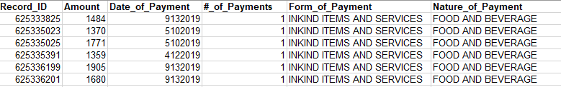
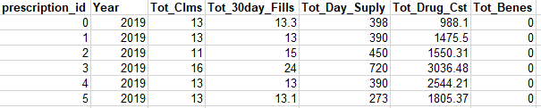
Data Integration - Other Nodes
Payment Node:
Payment node extracted exclusively from Sunshine Act data
Utilized integrated manufacturer and physician nodes to identify matched entities
Result: >1M payment nodes
Prescriptions Node:
Prescriptions node extracted exclusively from Medicare Part D data
Utilized integrated physicians and drug nodes to identify matched entities
Result: >2M prescription nodes
Notes:
Lam

Slide 12





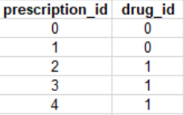
Data Integration - Edges
Edge Number | Edge Name | Node From | Node To | # of Edges
1 | Paid | Manufacturer | Payments | >1M
2 | Manufactures | Manufacturer | Drug | >12k
3 | Related To | Payments | Drug | >97k
4 | Paid To | Payments | Doctor | >1M
5 | Prescribed | Doctor | Prescription | >2M
6 | For | Prescription | Drug | >2M
1
2
3
4
5
6
Notes:
Jonah
(m:Manufacturer) -[:paid]-> (p:Payments)
I could show this like in cypher, i.e. (Manufacturer: m) -[Paid]-> (Payments: p)

Slide 13
Data Integration - Papermill Demo
Notes:
Jeff is running this demo
(m:Manufacturer) -[:paid]-> (p:Payments)
I could show this like in cypher, i.e. (Manufacturer: m) -[Paid]-> (Payments: p)

Slide 14
Loading Data Into neo4j
Integration pipeline produces a normalized table for each node type and edge type
Processed, integrated, and normalized tables simplify load script:
Load Nodes
Create Constraints & Indexes (drastically improves performance of edge loading & queries)
Load Edges
Notes:
Jeff - we structured our data integration to be normalized () tables that are easy to load

Slide 15
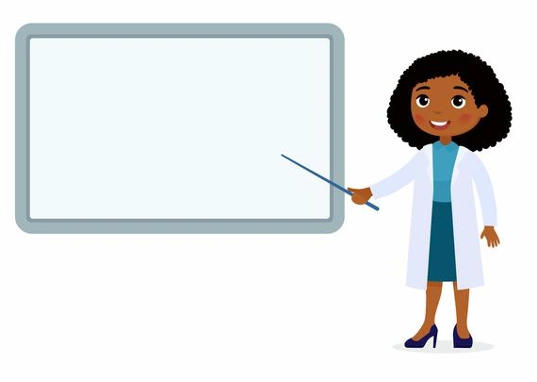

Demonstration
Hands On
Notes:
Jeff

Slide 16

Insights/Lessons Learned
Integrating Data
Modularity is critical in team development
Create pipelines
Create unique IDs for source data
Iterate on integration
Implementing neo4j
Set up all team member neo4j environments
Create indexes
Always scroll up
Teamwork
Pair/Triple programming
GitHub
Notes:
Jonah/Lam/Jeff

Slide 17
Conclusion/Future Work
Conclusion
Not able to identify network of abuse in knowledge graph
We do believe it is possible to find networks of abuse
It is a good thing that networks of abuse are hard to find
Future Work
Enhance integration pipeline to allow for easier in-line active labeling processes (a feature we did not incorporate into our Papermill workflow, yet)
Add parallelization to data integration pipeline
Domain expertise for matching drugs across different datasets & to create golden sets so we can better measure recall and precision.
Incorporate full Sunshine Act and Medicare Part D data for all 50 states and all available years.
Ability to incrementally ETL new data into our knowledge graph
Look into adding private prescription data
Include GPO ownership data
Notes:
Lam (main)/Jonah
GPO = group purchasing organizations

Slide 18

Questions
Notes:
Lam

Slide 19

Notes:
All of us

